Slide 1
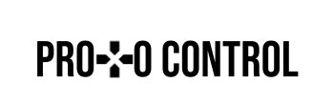
ProtoControl
Kelly Mae Allen, Abisha Fenn, Nida Kosedagi, Parker Sexton, William Wood

Slide 2
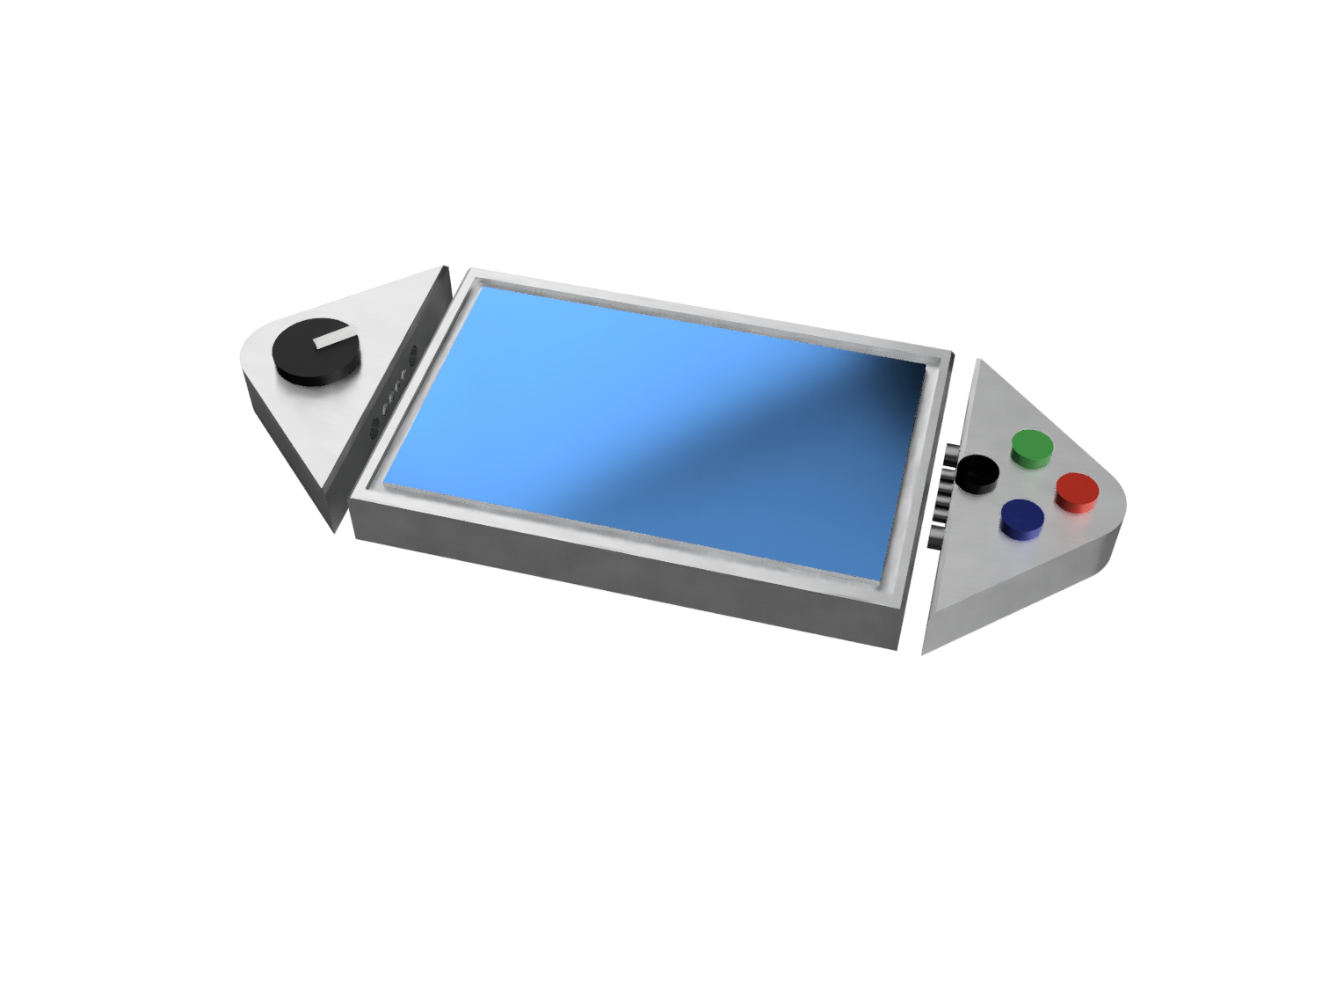
What is ProtoControl?
A plug and play panel with a start-to-finish user interface development experience.
Software platform to design user interface layout
Auto generated embedded code
Touch-screen display
Hot swappable hardware
Compatibility with industry standard technology
Notes:
Protocontrol allows engineers and hobbyists to execute their vision for a user interface panel with a start-to-finish user interface development experience
Bring the audience to the same place as us before diving into details, set the tone, differentiate ourselves from other projects

Slide 3





Meet The Team
Kelly Mae Allen (Team Lead)
Enclosure modeling & Power
Embedded software integration
Parker Sexton (Project Sponsor)
Embedded Software Integration
Software/website, Custom PCB design
Will Wood
Software and Website to Design Digital UI
Nida Kosedagi
Custom PCB Design
Serial Communication IC
Abisha Fenn
Serial Communication IC
Enclosure Modeling & Power

Slide 4
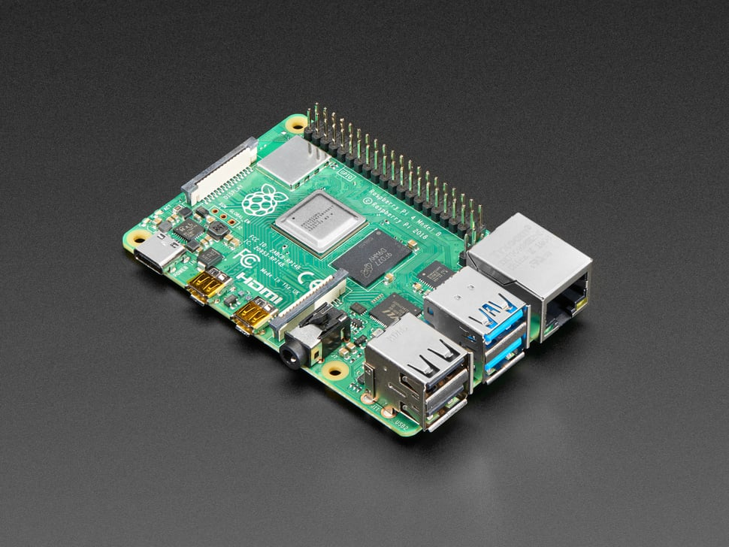
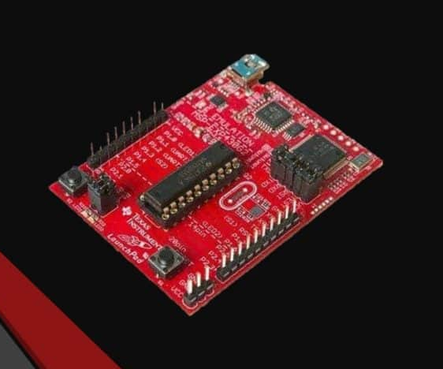
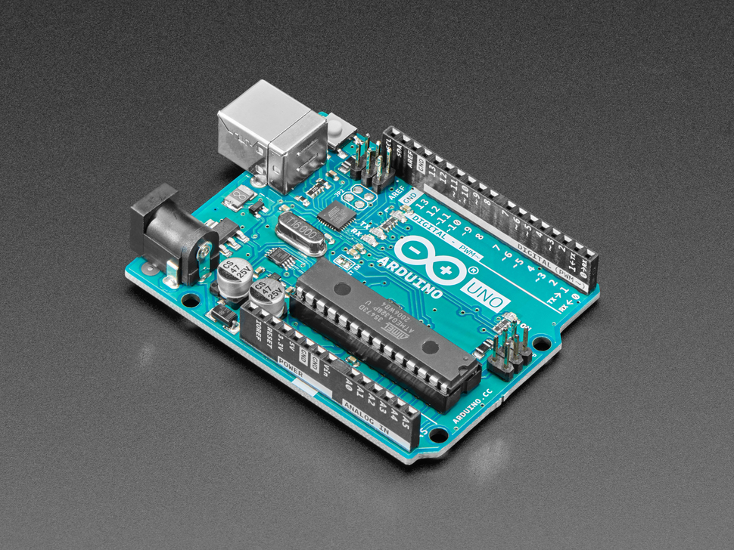
Integration with Independent Subsystems
Raspberry Pi
User System will have a camera system and speaker
MSP 430
User system will be the 306 Car
Arduino
User system will have a photoresistor and DC Motor
User System will connect to Protocontrol using the UART Communication Protocol

Slide 5
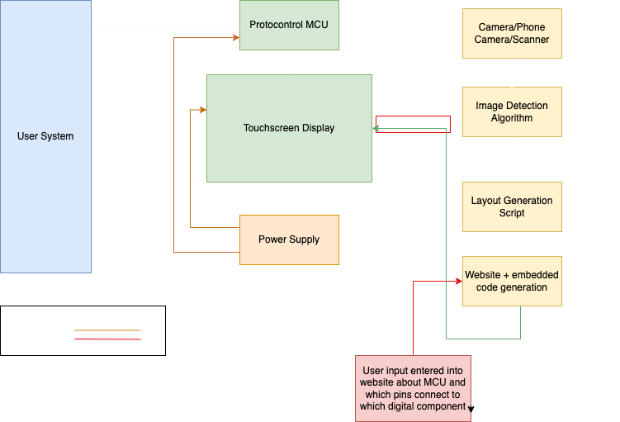

Slide 6
User Flow Diagram
Designing of User Interface
Implementation With User System
Functionality While User System is Running
User Chooses Layout of Components
User Implements Configuration Commands
Protocontrol Monitors UART Channel for Commands
User Configures Component Properties
User Implements Component Output Receiver
Protocontrol Monitors Component State
Website Compiles Placement and Configuration
User Implements Read and Write Commands
Protocontrol Sends Component State Updates
Website Produces Configuration Commands
User Connects System UART Channels
User Monitors UART Channel for Component State

Slide 7
User Flow Diagram
Designing of User Interface
Implementation With User System
Functionality While User System is Running
User Chooses Layout of Components
User Implements Configuration Commands
Protocontrol Monitors UART Channel for Commands
User Configures Component Properties
User Implements Component Output Receiver
Protocontrol Monitors Component State
Website Compiles Placement and Configuration
User Implements Read and Write Commands
Protocontrol Sends Component State Updates
Website Produces Configuration Commands
User Connects System UART Channels
User Monitors UART Channel for Component State

Slide 8
User Flow Diagram
Designing of User Interface
Implementation With User System
Functionality While User System is Running
User Chooses Layout of Components
User Implements Configuration Commands
Protocontrol Monitors UART Channel for Commands
User Configures Component Properties
User Implements Component Output Receiver
Protocontrol Monitors Component State
Website Compiles Placement and Configuration
User Implements Read and Write Commands
Protocontrol Sends Component State Updates
Website Produces Configuration Commands
User Connects System UART Channels
User Monitors UART Channel for Component State

Slide 9
User Flow Diagram
Designing of User Interface
Implementation With User System
Functionality While User System is Running
User Chooses Layout of Components
User Implements Configuration Commands
Protocontrol Monitors UART Channel for Commands
User Configures Component Properties
User Implements Component Output Receiver
Protocontrol Monitors Component State
Website Compiles Placement and Configuration
User Implements Read and Write Commands
Protocontrol Sends Component State Updates
Website Produces Configuration Commands
User Connects System UART Channels
User Monitors UART Channel for Component State

Slide 10
User Flow Diagram
Designing of User Interface
Implementation With User System
Functionality While User System is Running
User Chooses Layout of Components
User Implements Configuration Commands
Protocontrol Monitors UART Channel for Commands
User Configures Component Properties
User Implements Component Output Receiver
Protocontrol Monitors Component State
Website Compiles Placement and Configuration
User Implements Read and Write Commands
Protocontrol Sends Component State Updates
Website Produces Configuration Commands
User Connects System UART Channels
User Monitors UART Channel for Component State

Slide 11
User Flow Diagram
Designing of User Interface
Implementation With User System
Functionality While User System is Running
User Chooses Layout of Components
User Implements Configuration Commands
Protocontrol Monitors UART Channel for Commands
User Configures Component Properties
User Implements Component Output Receiver
Protocontrol Monitors Component State
Website Compiles Placement and Configuration
User Implements Read and Write Commands
Protocontrol Sends Component State Updates
Website Produces Configuration Commands
User Connects System UART Channels
User Monitors UART Channel for Component State

Slide 12
A plug and play panel with a start-to-finish user interface development experience
Software Support
Embedded System
User Designs Layout
Init Components
Convert to embedded code
Draw Static Images
Communicate with device
Init Components
Poll Auxiliary Components
Interface with user
Update Console
Design Challenges
Compatibility with multiple MCUs
Generating working embedded code
Controlling user system
Key features
Napkin-to-UI
No embedded knowledge needed
Plug and Play design
Serial communication protocol
Interchangeable tactile buttons, knobs, and sliders
Dedicated power supply

Slide 13
Prototype demo
User feedback
How intuitive does it feel as an end user?
How intuitive is it as a customer?

Slide 14
Thank you!

Slide 15
Appendix

Slide 16
Embedded Progress
Digital Components drawn based on SD card
Text file format created
Classes made for Increment, Pushbutton, and toggle
Console with updated values
Serial communication network with user system
Integration with other subsystems

Slide 17
Integration between Protocontrol and User System
Developed command protocol for communication between subsystems
+[command]|[parameters]
ex/ sending text from user system
+write|[line]|[start character]|[user text] \n
ex/ sending component state to user system
+out1|[state of component 1]\n
ex/ changing properties of digital components
+init|[component type]|[component location]|[identifier]\n
Integration
of Subsystems
Website
Protocontrol System
User System
Built Sample User Systems
Arduino
Raspberry Pi

Slide 18
Integration between Protocontrol and User System

Slide 19
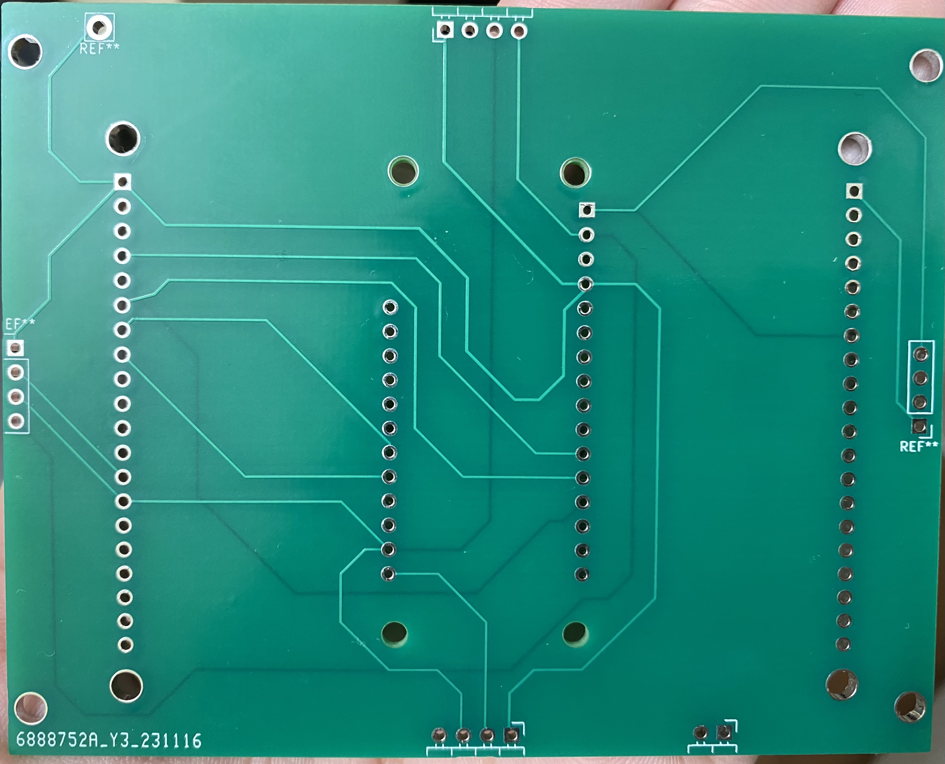
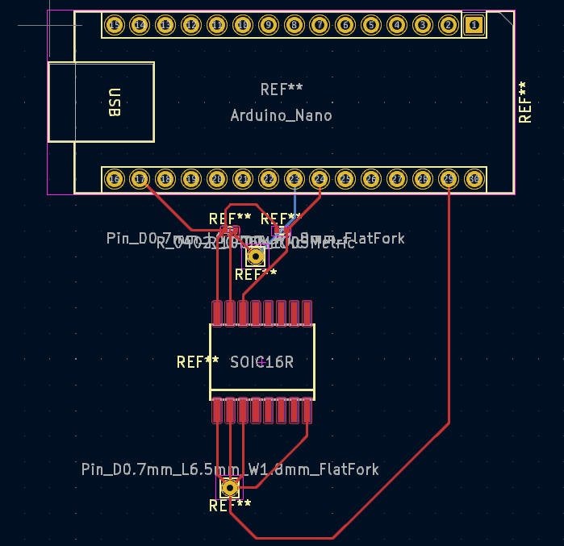
PCB design progress
Progress & Status: Main PCB printed and working
Lessons Learned: Importance of test points, avoiding 90 degree angles, ground travelling parallel to clock traces, flooding a part of the PCB with ground plane
Main PCB
Next Steps: Redesign the I2C pin order to ensure consistent component orientation across sides, design component PCBs to work with PCF8574 (bulk capacitors and more resistors to be added)
Component PCB (PCF8574 & Arduino Nano) - In progress

Slide 20

Hardware Design + Serial Communication progress
Successfully interfaced PCF8574N GPIO Expander with button and led (non-I2C to I2C)
Lessons Learned:
Always check the part id when it arrives in the mail
Next Steps
Interface keypad, slider, and toggles
Make Schematic for PCB (replicate the pin expander)
Use magnetic I2C pogo connectors
Define a more robust way of integrating components (w/o dependence on specific libraries)
Notes:
People Responsible: Abisha, Parker
Next Steps
Interface keypad, slider, and toggles
Buy TIs PC8574 IC and make a Schematic for PCB (replicate the pin expander)
Continue Verilog Modeling of I2C
Explore what modules we have available to us with Vivado

Slide 21

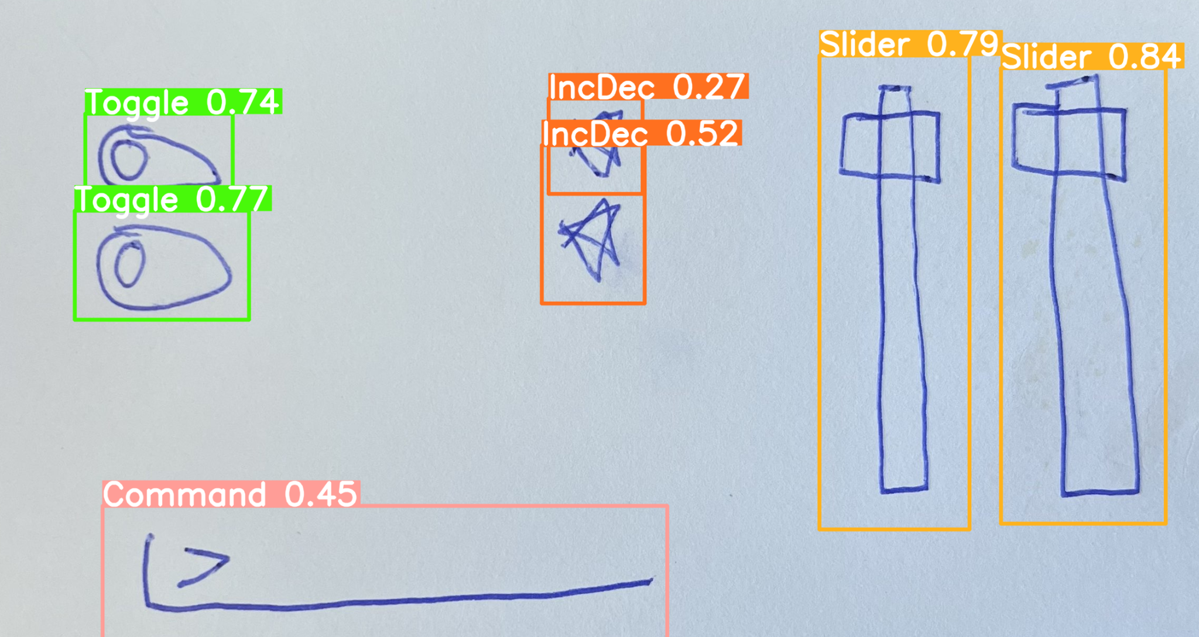
Software Progress
What’s been done:
Optimized image processing & object detection algorithm
New round of training data coming soon
Added and refactored templated embedded code
Looked into web hosting options provided by NCSU
Cross-Platform Application Development
Android/IOS
More info to come (Timeline, Concept Diagrams)

